Slide 1


Xamarin Case-Study
OTLOB
s

Slide 2
Done By
Zeyad Alaa-Eldeen
Karim Fayed
Ahmed Hany Hassan

Slide 3
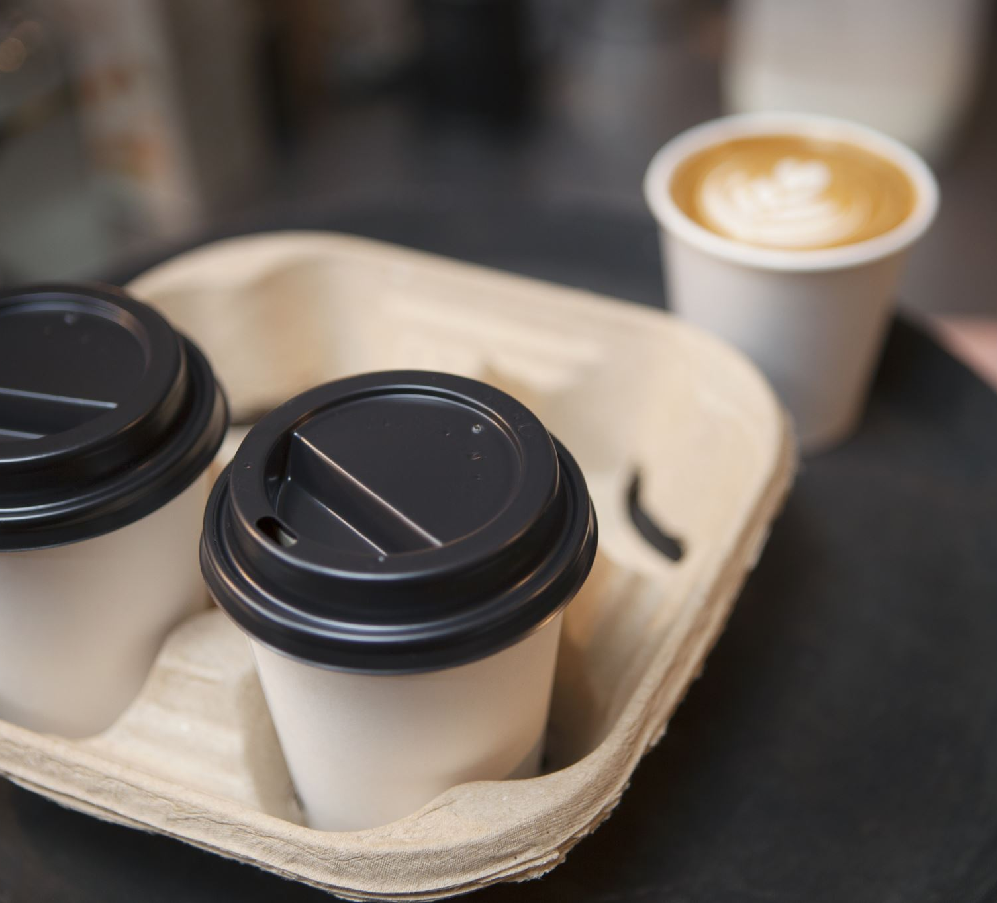
Objective and services
This application is developed to provide an online platform for ordering food, medicine, groceries, and cosmetics.

